Slide 1

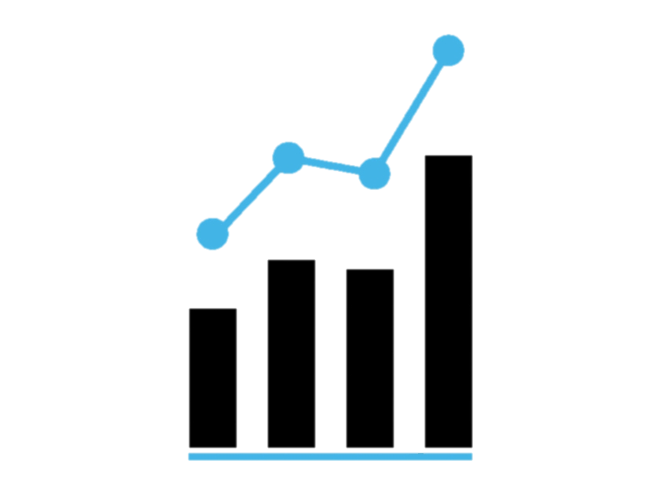


Zomato Analytics Project Presentation
Made By
Group 3

Slide 2
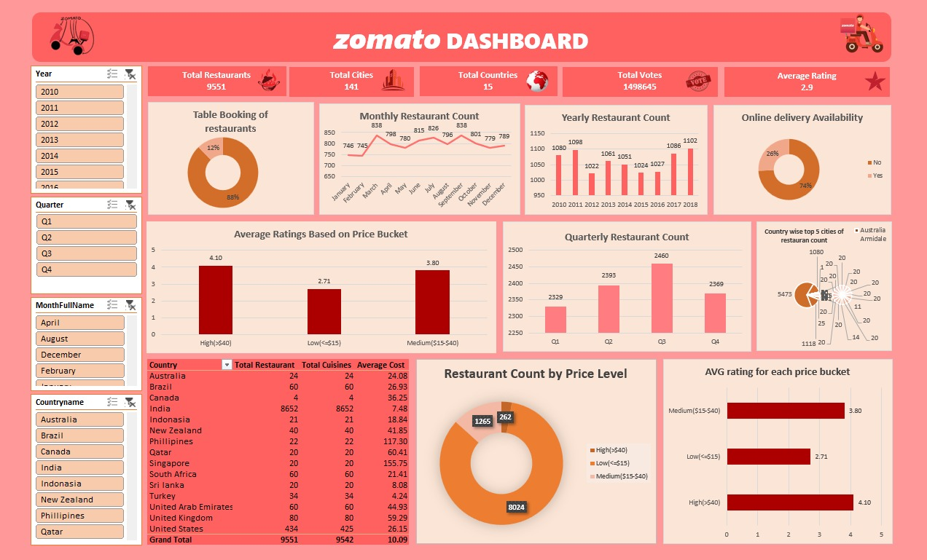
Excel Dashboard

Slide 3
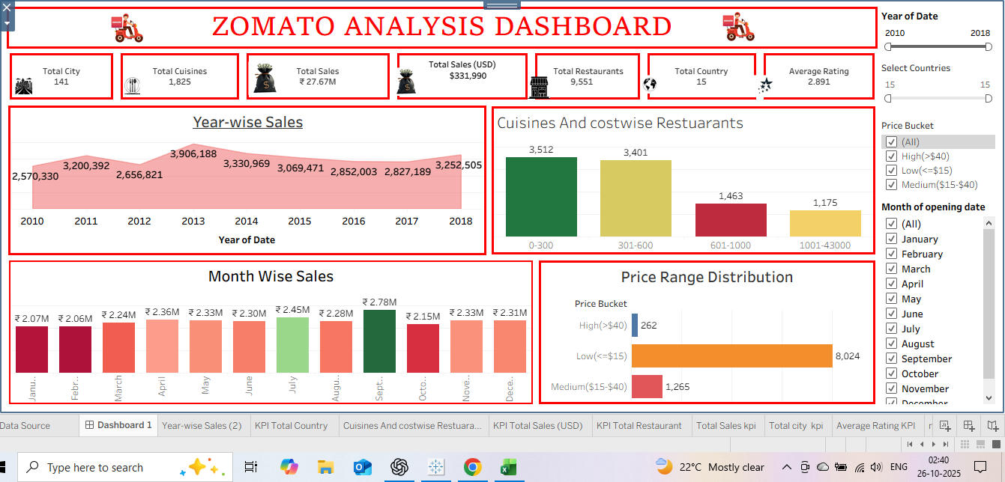
Tableau Dashboard

Slide 4
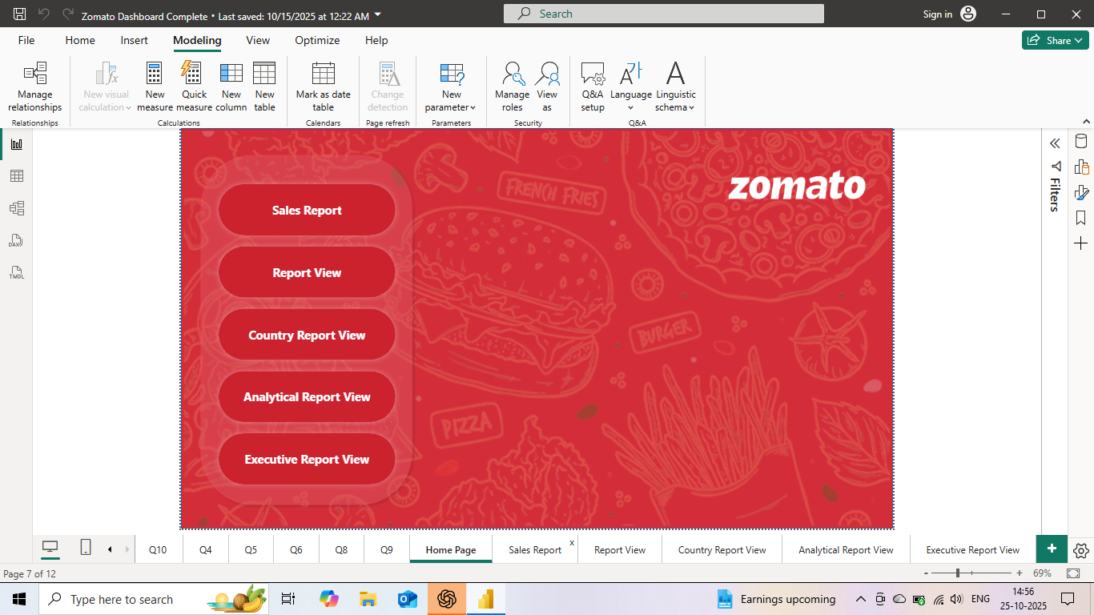
Power Bi Dashboard
Home Page

Slide 5
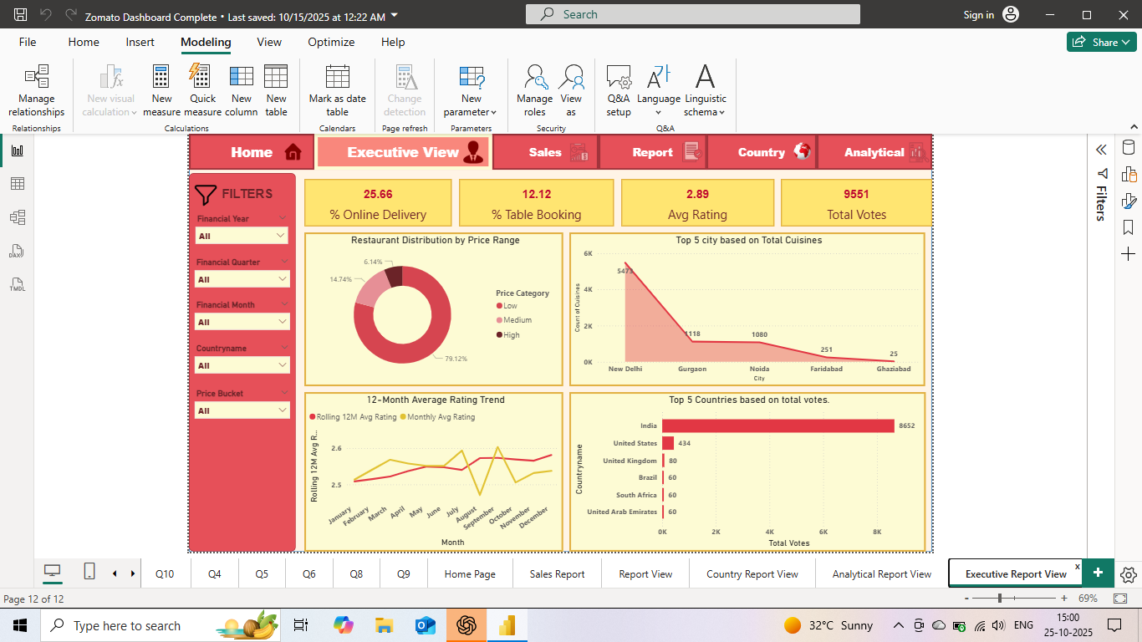
Executive View

Slide 6
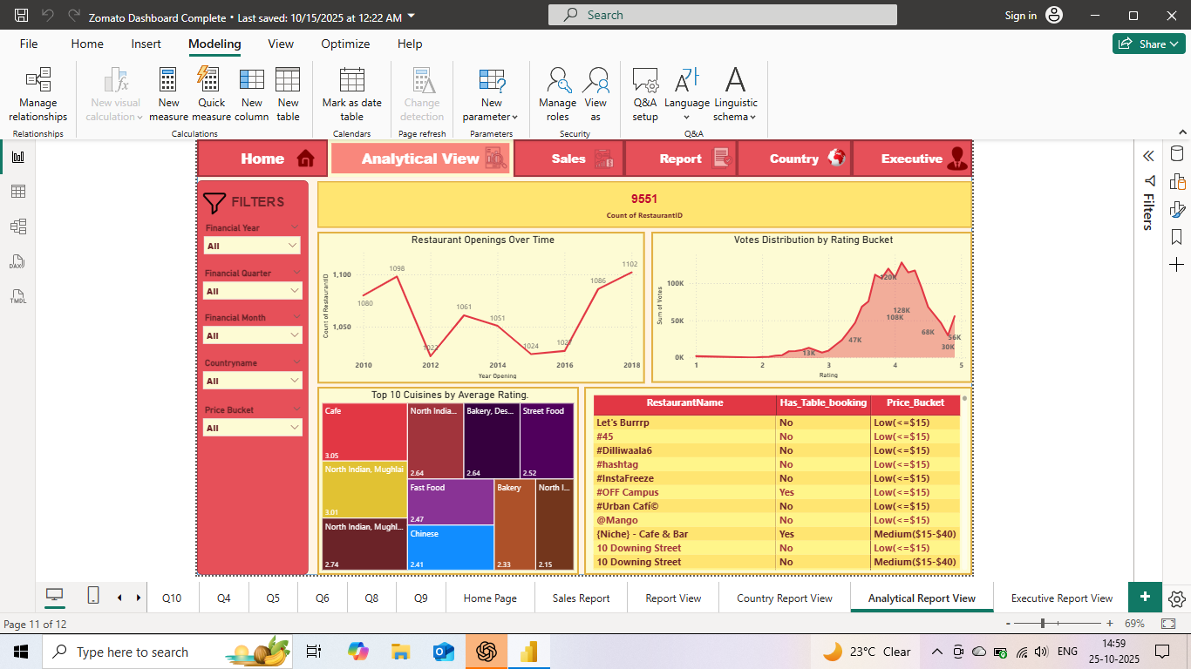
Analytical Report View

Slide 7
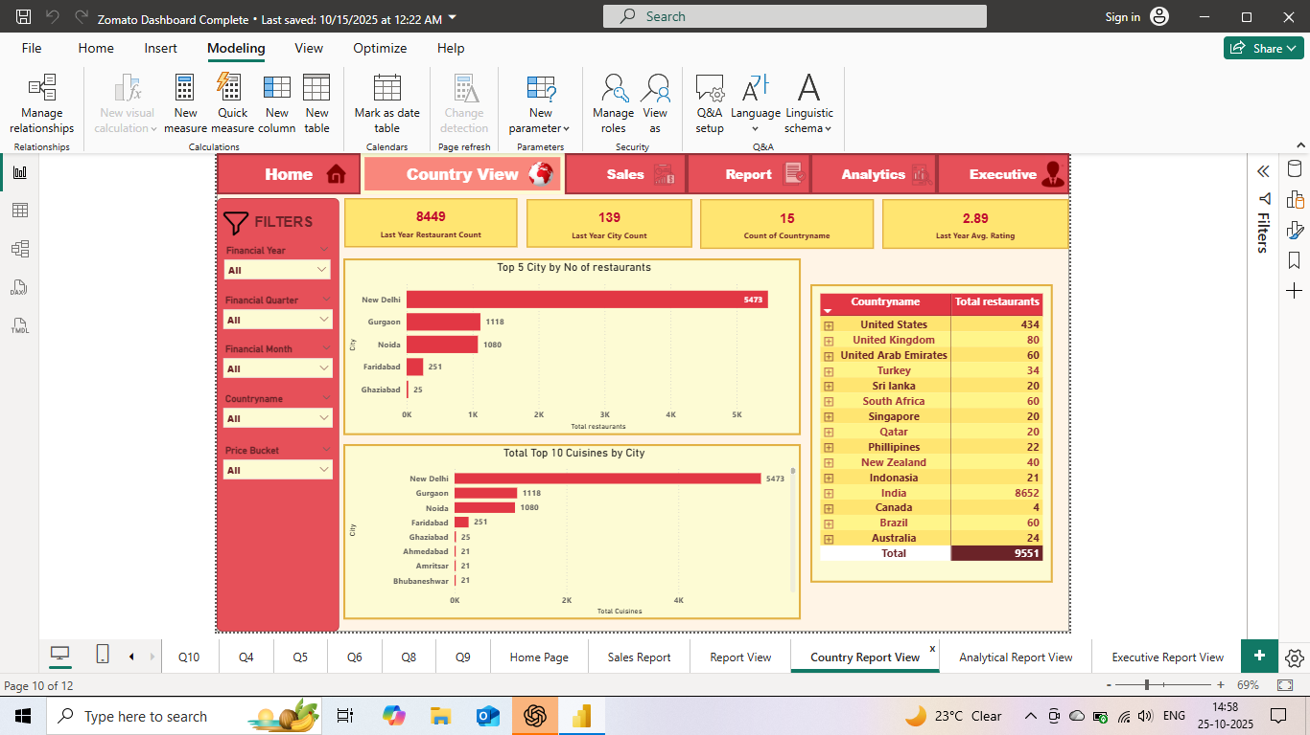
Country Report View

Slide 8
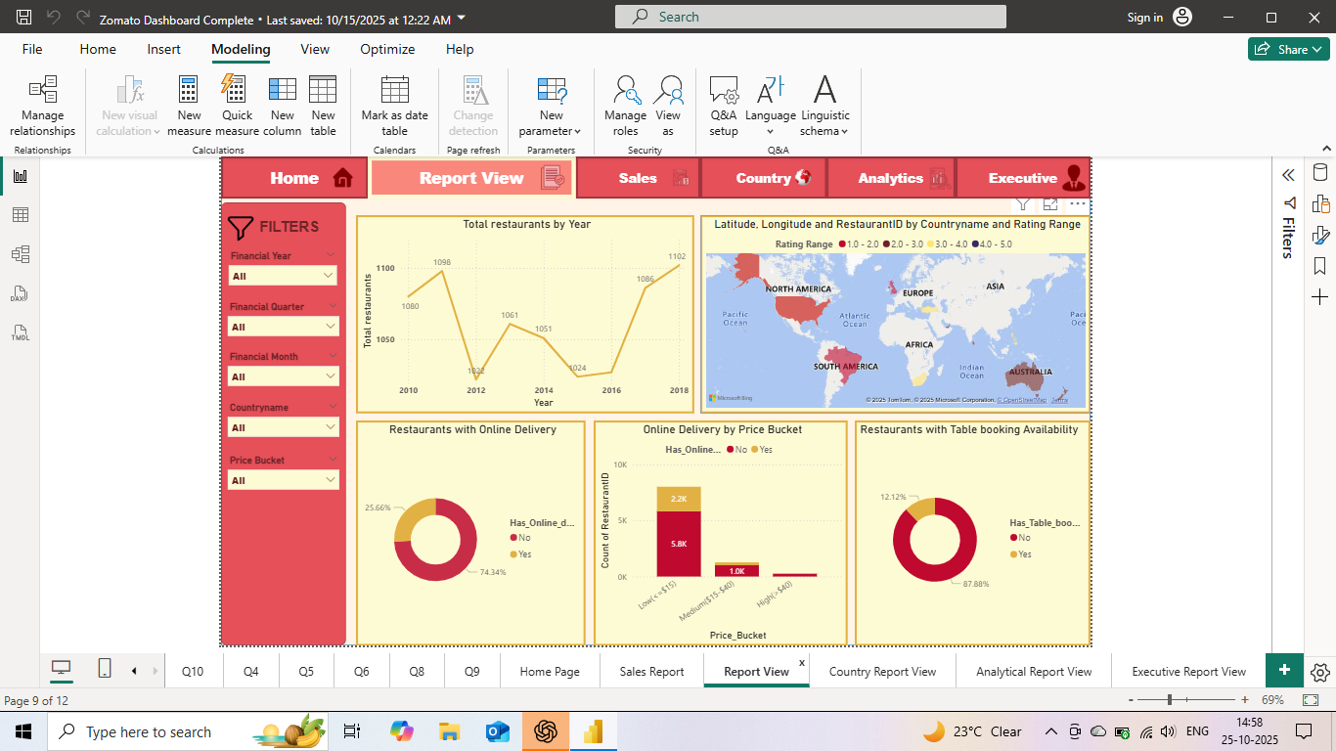
Report View

Slide 9
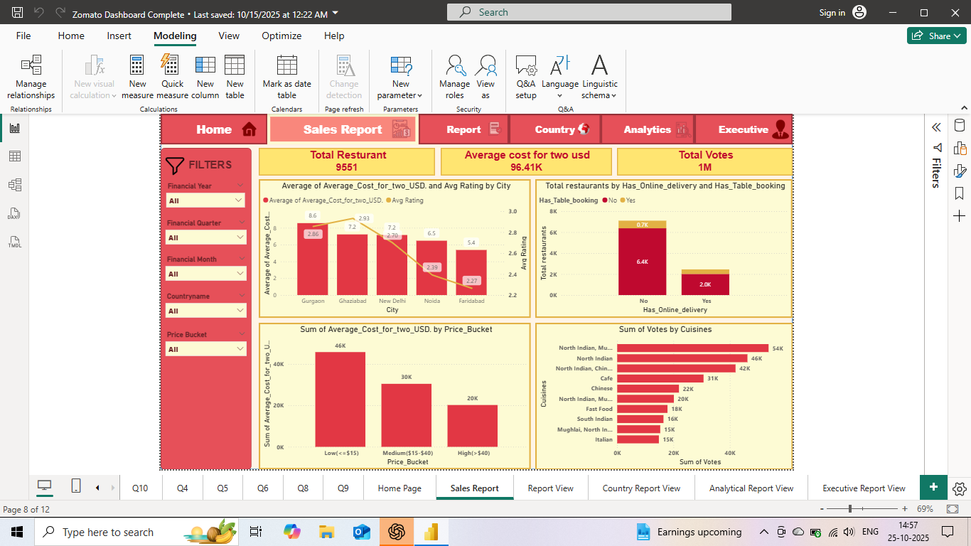
Sales Report

Slide 10
Challenges & Counters
1.Dashboard Performance: Optimized Dashboard performance by using data extracts and reducing heavy calculations by using Dax function in Excel ,power Bi & tableau.
2. Visual Selection: Used clear, meaningful charts to improve readability.
3. Actionable Insights: Focused on highlighting key metrics and trends for better decision-making.
4. Formatting Dashboards : Used color grading to Make dashboard familiar to the client's website.
5. ⁠Communication & collaboration: We worked remotely, the only channel for coordination were chat and zoom meet which sometime causes delay, misunderstandings about task. We scheduled short , focused zoom meet and ensured everyone was aligned

